Slide 1


React JS
(Lifecycle of a component)
Lecture-28

Slide 2
Today’s Agenda
React Component Life Cycle Phases
React Component Life Cycle Methods
Mounting Phase Methods
Updating Phase Methods
Unmounting Phase Methods

Slide 3
Life Cycle Phases
A React component goes through different phases as it lives in an application, though it might not be evident that anything is happening behind the scenes.
A component’s lifecycle can be divided into 4 parts:
Mounting
Updating
Unmounting
Error handling

Slide 4
Life Cycle Phases
Mounting — an instance of a component is being created and inserted into the DOM.
Updating — when the React component is born in the browser and grows by receiving new updates.
Unmounting — the component is not needed and gets removed
Error handling — called when there is an error during rendering, in a lifecycle method, or in the constructor of any child component. We will discuss this phase during Error Boundaries

Slide 5
Life Cycle Methods
In every phase of its life , a React component has certain lifecycle methods automatically called by React .
We can override these methods and insert our own code in them to be executed at a particular moment during the lifecycle of the component.

Slide 6
How Many LifeCycle Methods
Are There ?
Overall we have 10 unique life cycle methods and they are called during different phases of a component’s life cycle
These are:
Mounting :
constructor()
getDerivedStateFromProps()
render()
componentDidMount()
Updating :
getDerivedStateFromProps()
shouldComponentUpdate()
render()
getSnapshotBeforeUpdate()
componentDidUpdate()

Slide 7
How Many LifeCycle Methods
Are There ?
UnMounting :
componentWillUnmount()
Error Handling:
getDerivedStateFromError()
componentDidCatch()

Slide 8
What We Will Discuss Now ?
Initially we will discuss Mounting , Updating and Unmounting phase methods only.
Error handling phase will make sense when we will discuss another topic in React called Error Boundaries

Slide 9
Mounting Phase Methods
constructor(props):
It is the very first method called as the component is “brought to life.”
The constructor method is called before the component is mounted to the DOM.
It is mostly used for initializing state and binding event handlers methods
It should never be used for AJAX Requests or setting up timers

Slide 10
Mounting Phase Methods
static getDerivedStateFromProps(props,state)
When mounting, the method getDerivedStateFromProps() is the last method called before rendering.
We can use it to set the state according to the initial props
Instead of calling setState() , the method getDerivedStateFromProps() simply returns an object containing the updated state or null if no update in state is needed
It should also never be used for AJAX Requests or setting up timers

Slide 11
Mounting Phase Methods
class MyComponent extends React.Component {
...
static getDerivedStateFromProps(props, state) {
return {
message: 'updated msg',
}
}
// or we can return null to make no update
static getDerivedStateFromProps(props, state) {
return null
}
// ...
}

Slide 12
Special Point !
Note that we could have placed this code in the constructor.
The advantage of getDerivedStateFromProps() is that it is more intuitive—it’s only meant for setting state, whereas a constructor has multiple uses.
Moreover getDerivedStateFromProps() is also called both before mount and before updating

Slide 13
Mounting Phase Methods
render()
Called after, the method getDerivedStateFromProps()
In this step, the UI component is rendered as it outputs HTML to DOM.
The only task this method must do is read props and state and render JSX.
It should be pure , that is , it should not call setState() or interact with external API

Slide 14
Mounting Phase Methods
componentDidMount()
Called after the render() method as soon as the component is mounted (inserted into the tree)
When this method is called, we know for sure that we have a UI element which is rendered.
So this is a good place to do a fetch request to the server or set up subscriptions (such as timers).
Example
componentDidMount() {
this.interval = setInterval(this.fetchWeather, 15000);
}

Slide 15
Example
Parent.js
import React, { Component } from "react";
import Child from "./Child";
export default class Parent extends Component {
constructor(props) {
super(props);
this.state = { name: "Sachin" };
console.log("Parent Component constructor() Called");
}
static getDerivedStateFromProps(props, state) {
console.log("Parent Component getDerivedStateFromProps() Called");
return null;
}
componentDidMount() {
console.log("Parent Component componentDidMount() Called");
}
render() {
console.log("Parent Component render() Called");
return (
<div>
<div>Parent</div>
<div>
<Child />
</div>
</div>
);
}
}

Slide 16
Example
Child.js
import React, { Component } from "react";
export default class Child extends Component {
constructor(props) {
super(props);
this.state = { name: "Sachin" };
console.log("Child Component constructor() Called");
}
static getDerivedStateFromProps(props, state) {
console.log("Child Component getDerivedStateFromProps() Called");
return null;
}
componentDidMount() {
console.log("Child Component componentDidMount() Called");
}
render() {
console.log("Child Component render() Called");
return <div>Child</div>;
}
}

Slide 17
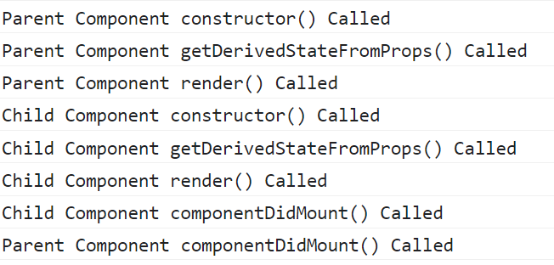
OUTPUT

Slide 18
Updating Phase
Whenever a change is made to the state or props of a React component, the component is re-rendered.
In simple terms, the component is updated.
This is the updating phase of the React component lifecycle.

Slide 19
Updating Phase Methods
static getDerivedStateFromProps(props,state)
It is the first method in React lifecycle to be invoked during the updating phase.
We have already discussed this method when reviewing the mounting lifecycle phase.
What’s important to note is that this method is invoked in both the mounting and updating phases.

Slide 20
Updating Phase Methods
shouldComponentUpdate(nextProps,nextState)
The second method called in updating phase is the shouldComponentUpdate()
It is used for controlling re-rendering as it returns a boolean which helps React decide whether the component must be re-rendered or not.
By default, or in most cases, we’ll want a component to re-render when the state or props change.
This lifecycle method is mostly used for performance optimization measures.

Slide 21
Updating Phase Methods
class CounterButton extends React.Component {
constructor(props) {
super(props);
this.state = {count: 1};
}
shouldComponentUpdate(nextProps, nextState) {
if (this.state.count !== nextState.count) {
return true;
}
return false;
}
render() {
return (
<div>
<Button
onClick={() => this.setState(state => ({count: state.count + 1}))}
/>
<p>Count: {this.state.count}</p>
</div>
);
}
}

Slide 22
Special Point !
In this code, shouldComponentUpdate() is just checking if there is any change in this.state.count.
If its values doesn’t change, the component doesn’t update.

Slide 23
Special Point !
If our component is more complex, we could use a similar pattern of doing a “shallow comparison” between all the fields of the props and state to determine if the component should update.
This pattern is common enough that React provides a helper to use this logic — just inherit from React.PureComponent.

Slide 24
Updating Phase Methods
class CounterButton extends React.PureComponent {
constructor(props) {
super(props);
this.state = {count: 1};
}
render() {
return (
<div>
<Button
onClick={() => this.setState(state => ({count: state.count + 1}))}
/>
<p>Count: {this.state.count}</p>
</div>
);
}
}

Slide 25
Updating Phase Methods
render(props,state)
After the shouldComponentUpdate() method is called, the render() method is called immediately afterwards depending on the returned value from shouldComponentUpdate(), which defaults to true.

Slide 26
Updating Phase Methods
getSnapshotBeforeUpdate(prevProps,prevState)
getSnapshotBeforeUpdate() is invoked right before the rendered output is committed to the DOM.
It enables our component to capture some information from the DOM (e.g. scroll position) before it is potentially changed.
Any value returned by this lifecycle will be passed as a parameter to componentDidUpdate().
This use case is not common, but it may occur in UIs like a chat thread that needs to handle scroll position in a special way.
A snapshot value (or null) should be returned.

Slide 27
Updating Phase Methods
componentDidUpdate(prevProps,prevState,snapShot)
This method is invoked once the update is done.
It takes in the previous props, previous state, and snapshot as parameters.
This is the perfect place to make network requests for the updated props.

Slide 28
Updating Phase Methods
componentDidUpdate(preProps) {
if(prevProps.userID !== this.props.userID){
fetch('https://pathToApi.com')
.then(resp => resp.json())
.then(respJson => {
// do what ever you want with your `response`
this.setState({
isLoading: false,
data: respJson,
});
})
}
}

Slide 29
Example
Parent.js
import React, { Component } from "react";
import Child from "./Child";
export default class Parent extends Component {
constructor(props) {
super(props);
this.state = { name: "Sachin" };
console.log("Parent Component constructor() Called");
}
changeState = () => {
this.setState({ name: "Sachin Kapoor" });
};
static getDerivedStateFromProps(props, state) {
console.log("Parent Component getDerivedStateFromProps() Called");
return null;
}
componentDidMount() {
console.log("Parent Component componentDidMount() Called");
}

Slide 30
Example
Parent.js
shouldComponentUpdate(nextProps, nextState) {
console.log("Parent Component shouldComponentUpdate() Called");
return true;
}
getSnapshotBeforeUpdate(prevProps, prevUpdate) {
console.log("Parent Component getSnapshptBeforeUpdate() Called");
return null;
}
componentDidUpdate(prevProps, prevState, snapShot) {
console.log("Parent Component componentDidUpdate() Called");
}
render() {
console.log("Parent Component render() Called");
return (
<div>
<div>Parent:{this.state.name}</div>
<div>
<Child />
</div>
<button onClick={this.changeState}>Click Me</button>
</div>
);
}
}

Slide 31
Example
Child.js
import React, { Component } from "react";
export default class Child extends Component {
constructor(props) {
super(props);
this.state = { name: "Sachin" };
console.log("Child Component constructor() Called");
}
static getDerivedStateFromProps(props, state) {
console.log("Child Component getDerivedStateFromProps() Called");
return null;
}
componentDidMount() {
console.log("Child Component componentDidMount() Called");
}

Slide 32
Example
Child.js
shouldComponentUpdate(nextProps, nextState) {
console.log("Child Component shouldComponentUpdate() Called");
return true;
}
getSnapshotBeforeUpdate(prevProps, prevUpdate) {
console.log("Child Component getSnapshptBeforeUpdate() Called");
return null;
}
componentDidUpdate(prevProps, prevState, snapShot) {
console.log("Child Component componentDidUpdate() Called");
}
render() {
console.log("Child Component render() Called");
return <div>Child</div>;
}
}

Slide 33
OUTPUT
Before button click

Slide 34
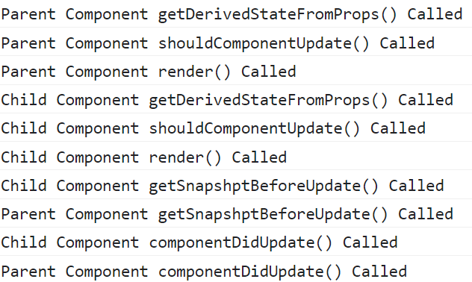
OUTPUT
After button click

Slide 35
Unmounting Phase Methods
componentWillUnmount()
componentWillUnmount() is invoked immediately before a component is unmounted and destroyed.
We should perform any necessary cleanup in this method, such as invalidating timers or canceling network requests or cleaning up any subscriptions that were created in componentDidMount().
Example
componentWillUnmount() {
clearInterval(this.interval);
}

Slide 36
How To UnMount
A React Component ?
It's possible for a specific component to be removed from the DOM after completion of an operation.
For this, React has a function called unmountComponentAtNode() that removes a component from a specific container.

Slide 37
How To UnMount
A React Component ?
The function unmountComponentAtNode() belongs to ReactDOM object and takes the container as argument from which the specific component should be removed.
Below is the basic syntax of the function unmountComponentAtNode():
ReactDOM.unmountComponentAtNode(<DOM element>);

Slide 38
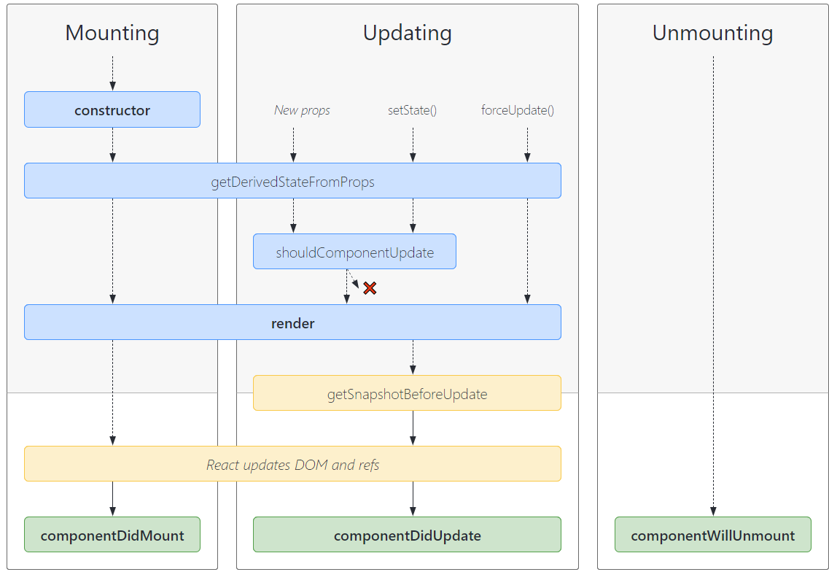
Final Summary

Slide 39
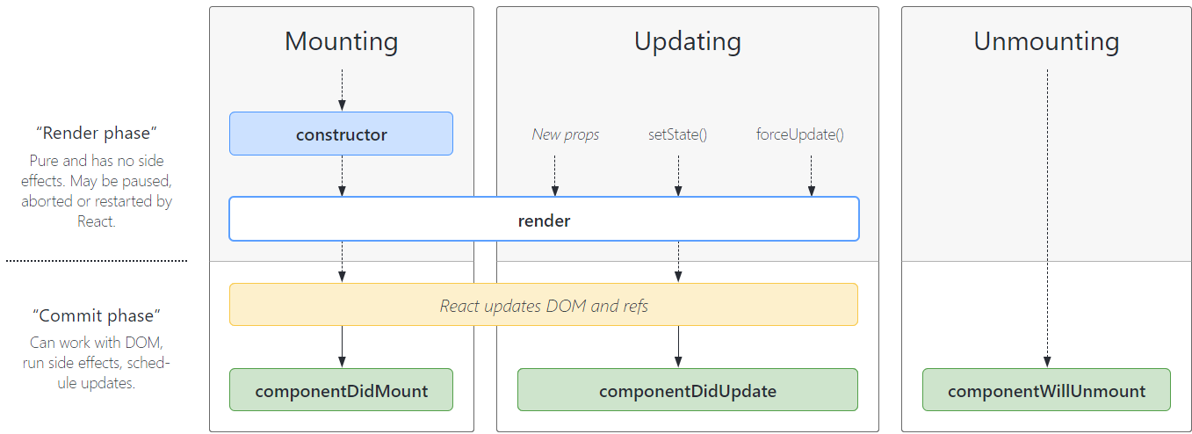
More Commonly Used

